Slide 1
Two routes towards fibre-integrated optical switching with single photons
Cameron McGarry
The University of Bath, United Kingdom
SPIE Photonics West, San Francisco
28th January 2024

Slide 2
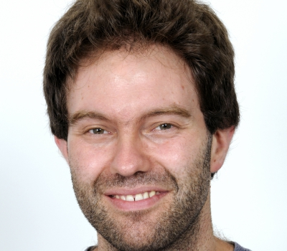
Centre for Photonics and
Photonic Materials
Tabijah Wasawo
Will Davis
Kerrianne Harrington
Kristina Rusimova
Tim Birks
Josh Nunn
Pete Mosley

Slide 3
Quantum technology
Bit (binary digit) → qubit (quantum binary digit)
Exploit quantum resources (superpositions, entangled states, etc.)
Promises improvements in:
Precision measurement
Tests of fundamental physics
Encryption & decryption
Drug discovery
Material development
Machine learning
Quantum chemistry
Whatever else you need to please your funding body

Slide 4
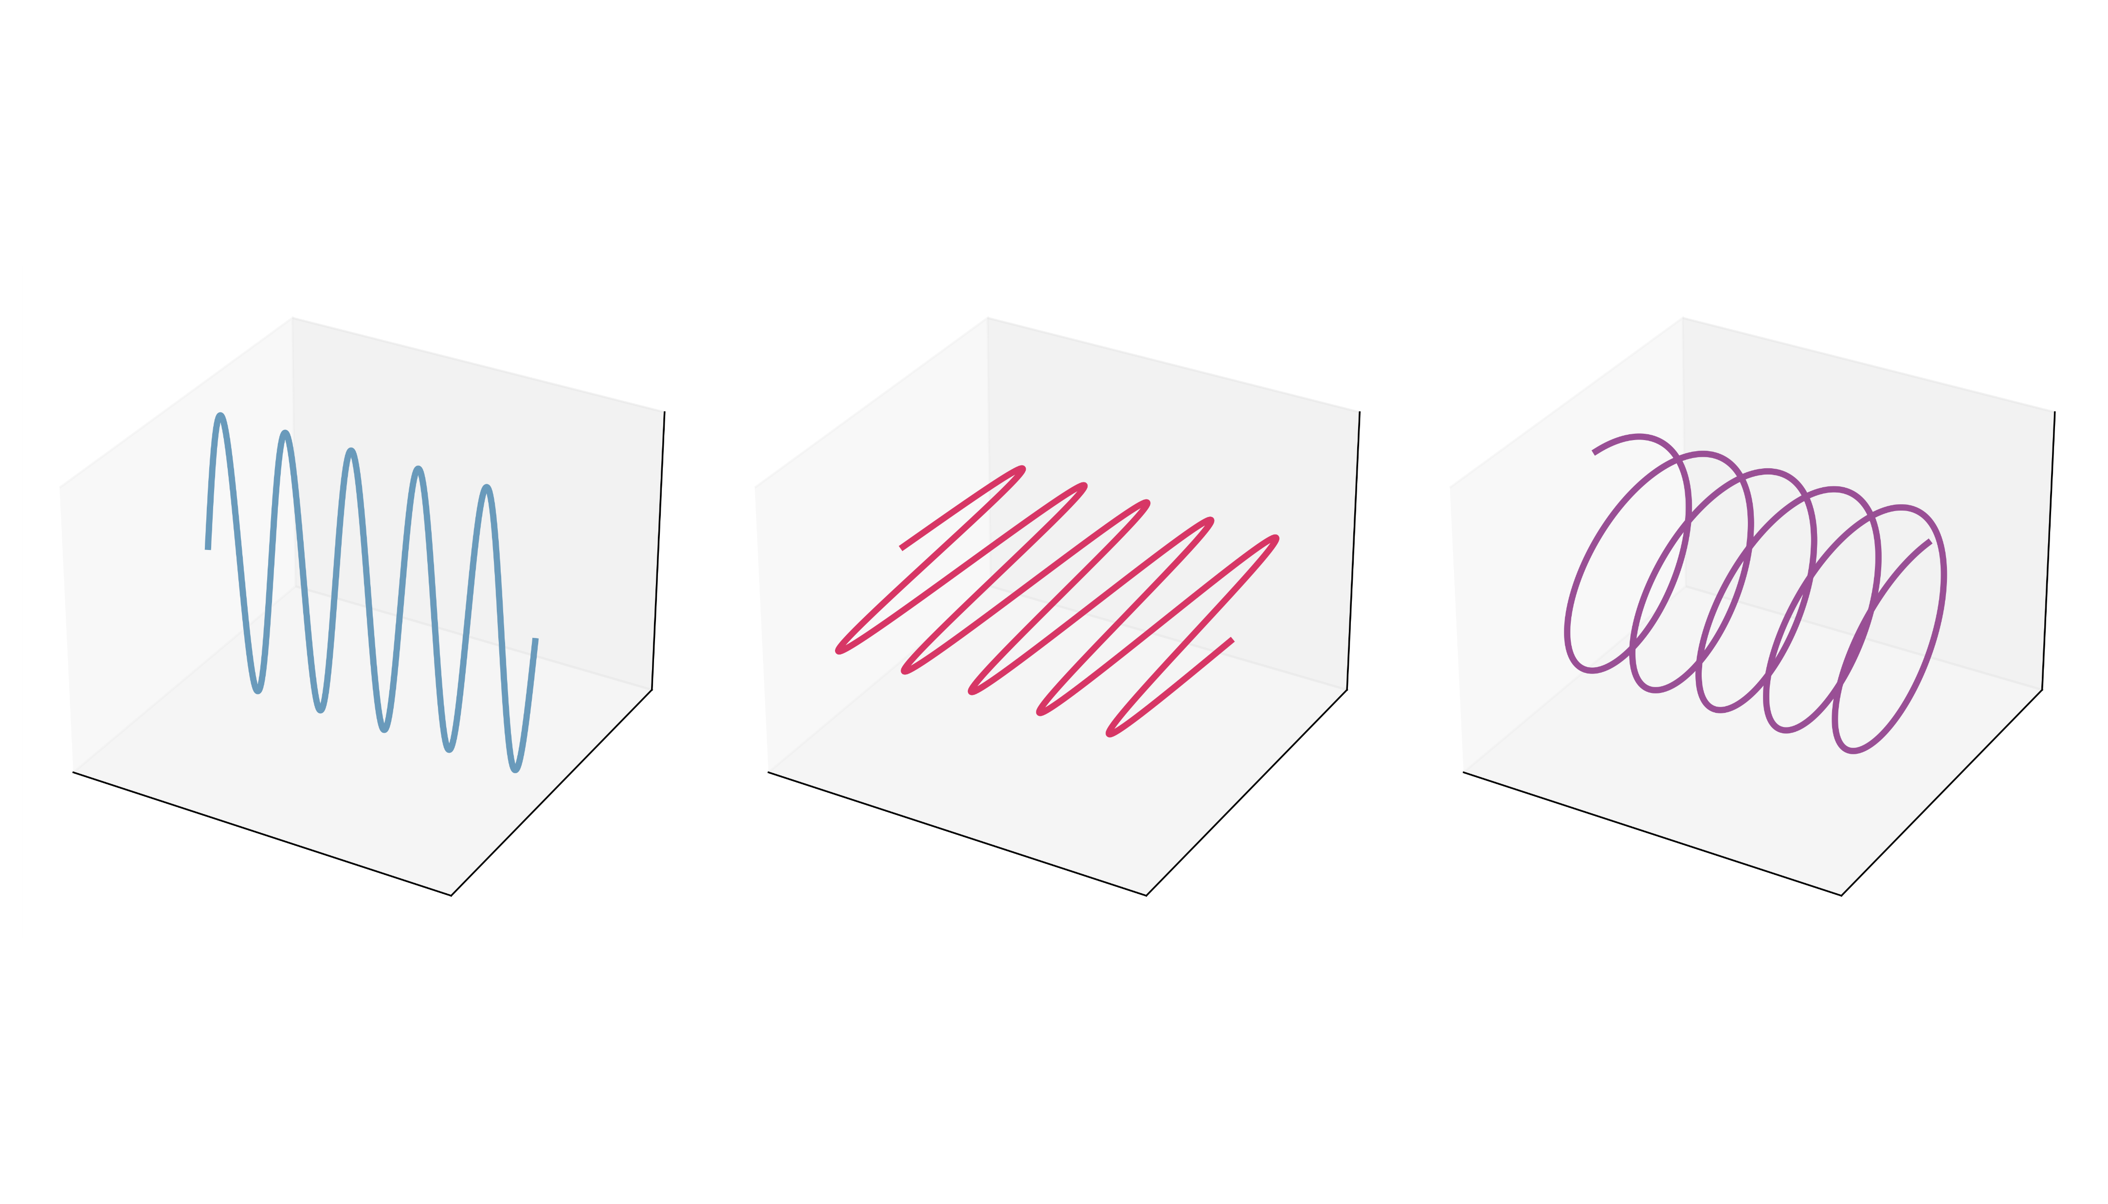
Photons are great for quantum tech
Encoding (e.g. in polarisation)
Low interaction with environment (low decoherence)
High bandwidth (flying qubits)
Readily confined to waveguides (inc. optical fibre)

Slide 5
How do you store a photon?

Slide 6
How do you store a photon?
Fast ladder memory (FLAME)
Ran Finkelstein et al. Fast, noise-free memory for photon synchronization at room temperature. Sci. Adv. 4, (2018). DOI:10.1126/sciadv.aap8598

Slide 7
FLAME: a memory, but with limited efficiency
Efficiency: 32(1)%
Storage time: 86(2) ns
Photon noise: 5.8(4) × 10⁻⁵
Recent improved memory
Efficiency: 39.8(6)%
Storage time: 113(2) ns
Photon noise: 1.2(2) × 10⁻⁵
Ran Finkelstein et al. Fast, noise-free memory for photon synchronization at room temperature. Sci. Adv. 4 (2018). DOI:10.1126/sciadv.aap8598
Davidson, O., Yogev, O., Poem, E. et al. Fast, noise-free atomic optical memory with 35-percent end-to-end efficiency. Commun Phys 6, 131 (2023). https://doi.org/10.1038/s42005-023-01247-4

Slide 8
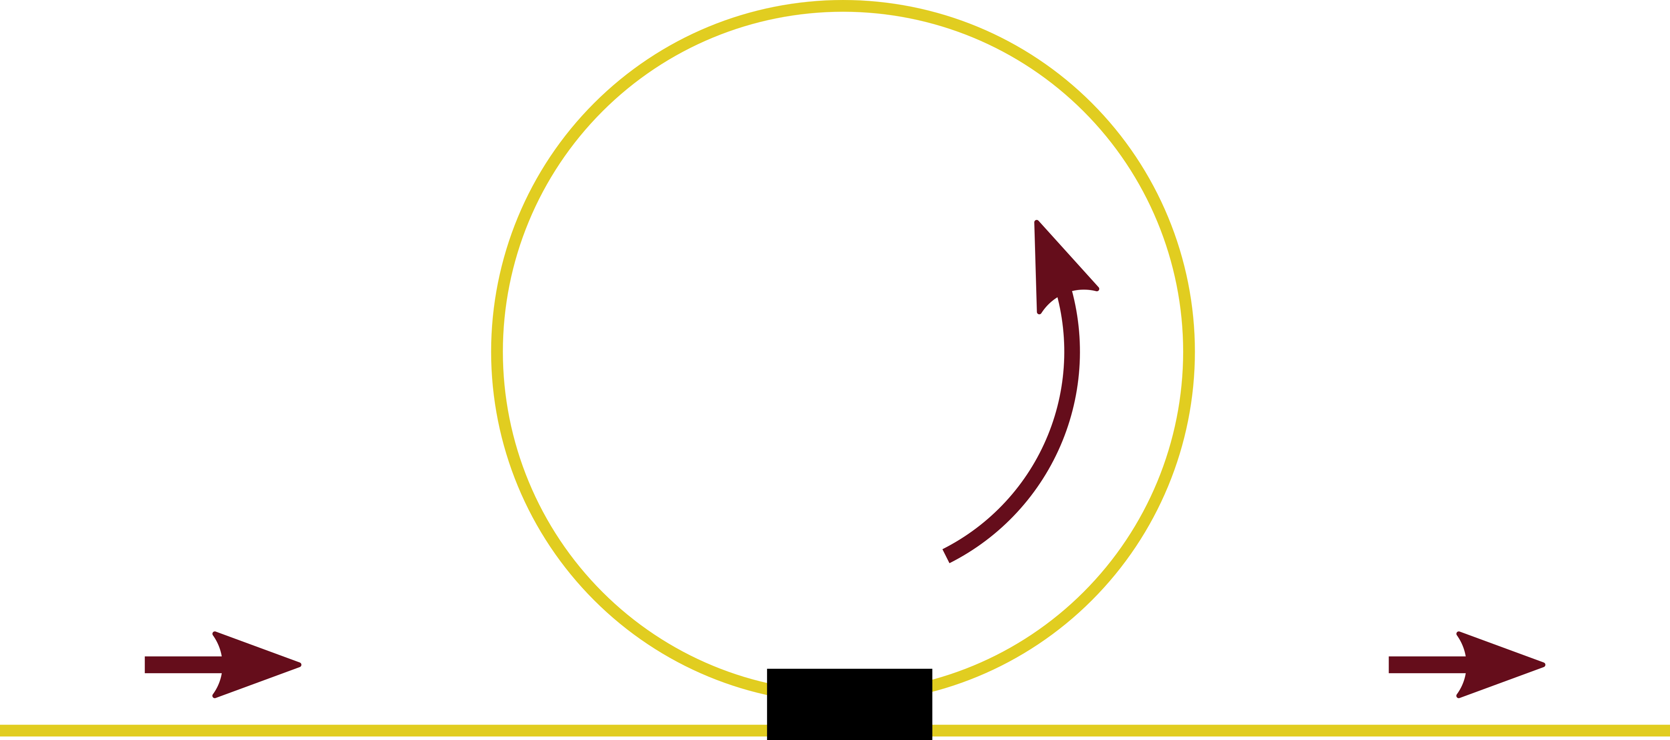
How do you store a photon?
Loop memory

Slide 9
How do you store a photon?
Loop memory
Switch

Slide 10
How do you store a photon?
Loop memory
Switch

Slide 11
How do you store a photon?
Loop memory
Switch requirements:
Fast
Low-loss
Switch

Slide 12
How do you store a photon?
How do you switch a photon?
Switch requirements:
Fast
Low-loss

Slide 13
How do you store a photon?
How do you switch a photon?
Switch requirements:
Fast
Low-loss
$$E$$
$$E\cos^{2}{\frac{Δφ}{2}}$$
$$E\sin^{2}{\frac{Δφ}{2}}$$

Slide 14
How do you store a photon?
How do you switch a photon?
How do you phase modulate a photon?

Slide 15
What’s my FLAME again?
Fast ladder memory (FLAME)
Ran Finkelstein et al. Fast, noise-free memory for photon synchronization at room temperature.Sci. Adv.4,eaap8598(2018). DOI:10.1126/sciadv.aap8598

Slide 16
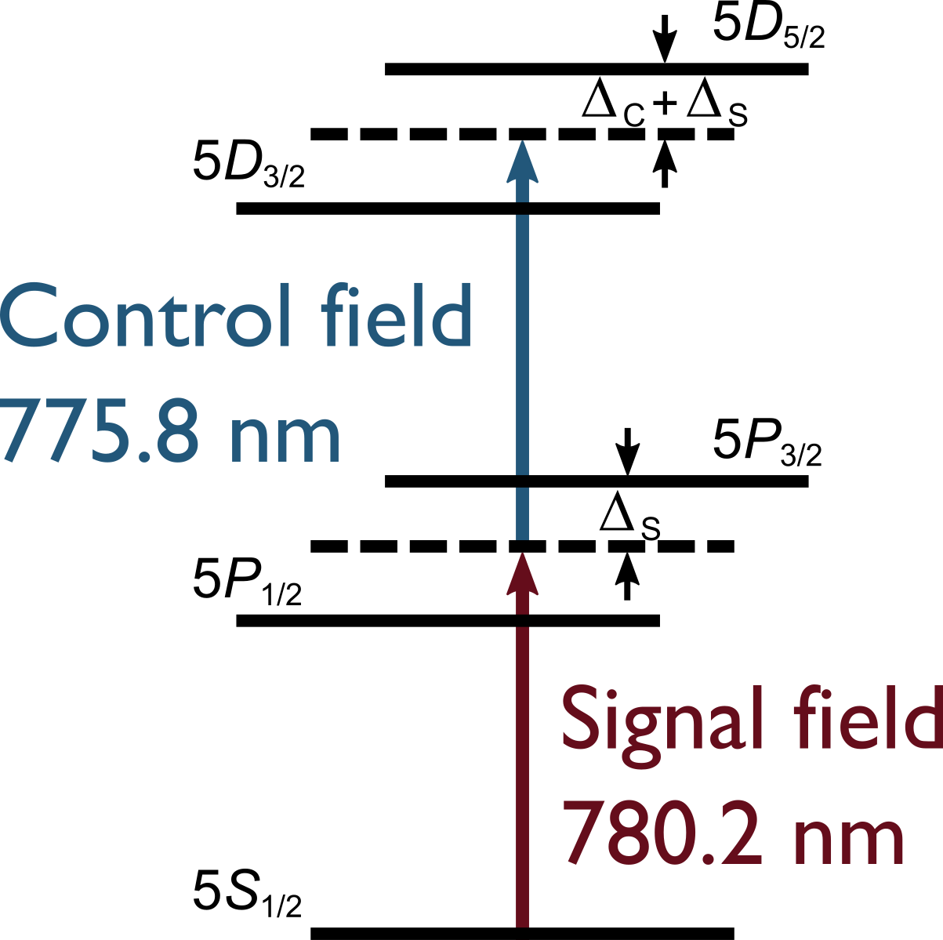
All-optical phase modulation
Control field on/off changes susceptibility
Hence introduces phase shift

Slide 17
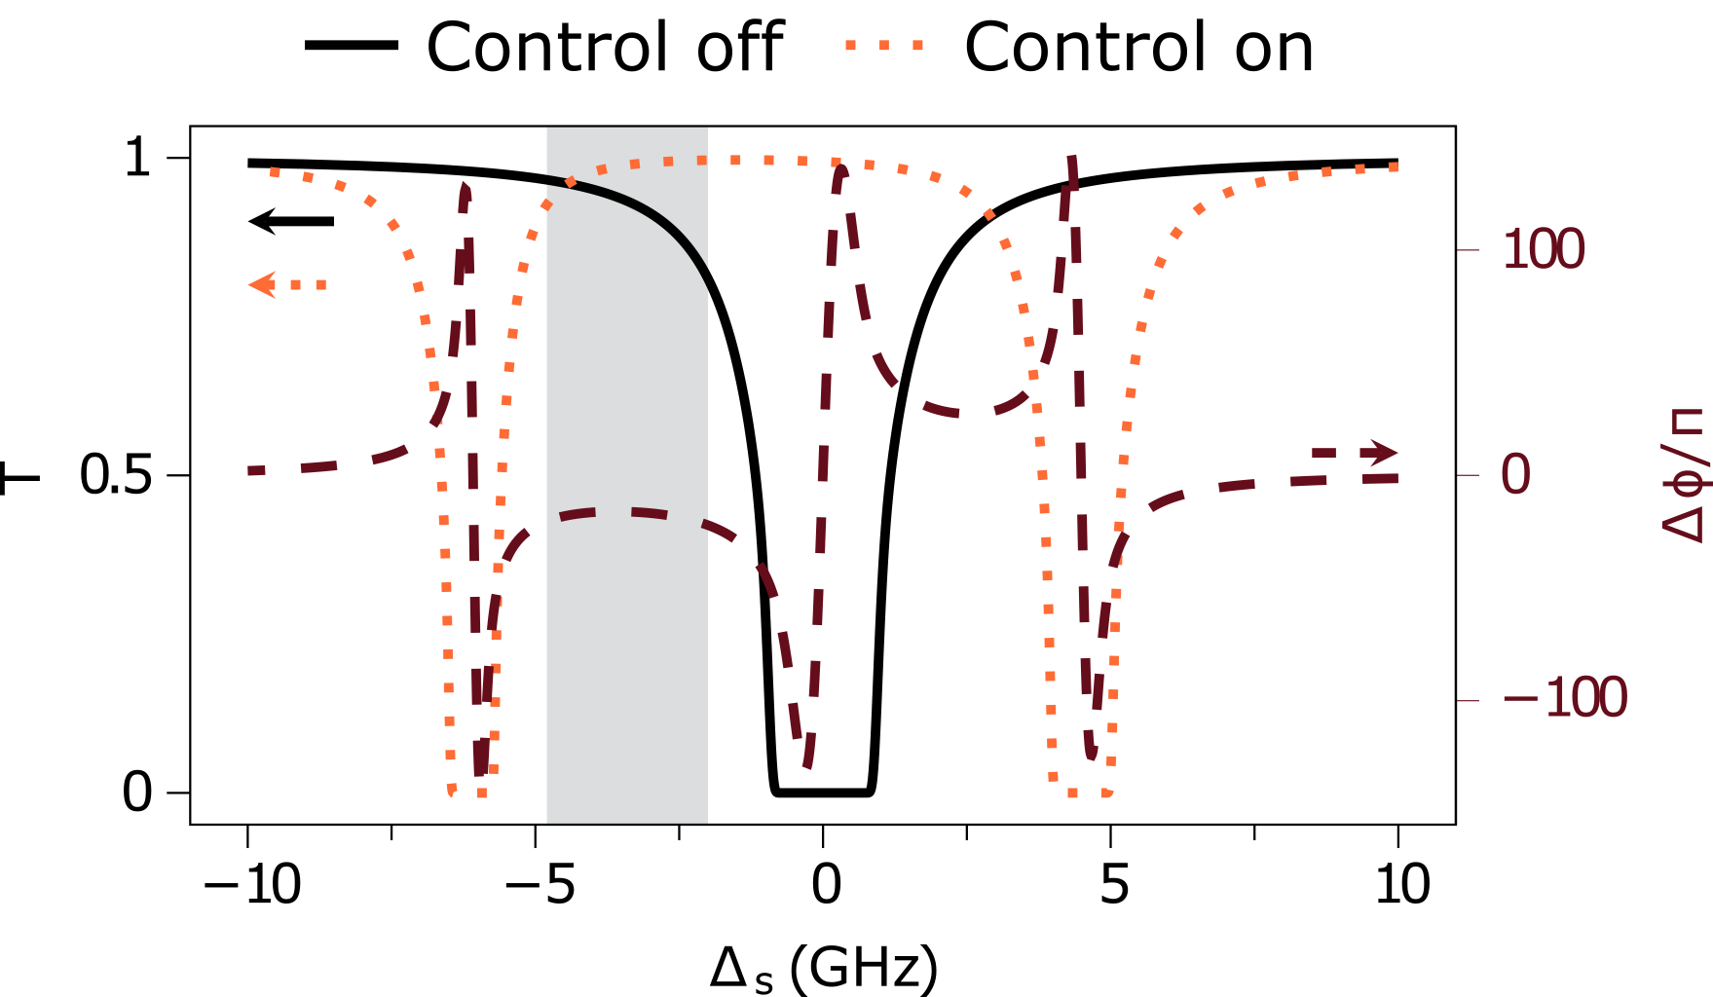
All-optical phase modulation

Slide 18
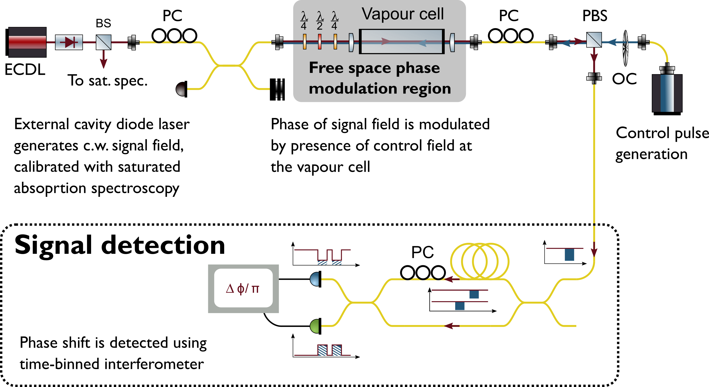
All-optical phase modulation

Slide 19
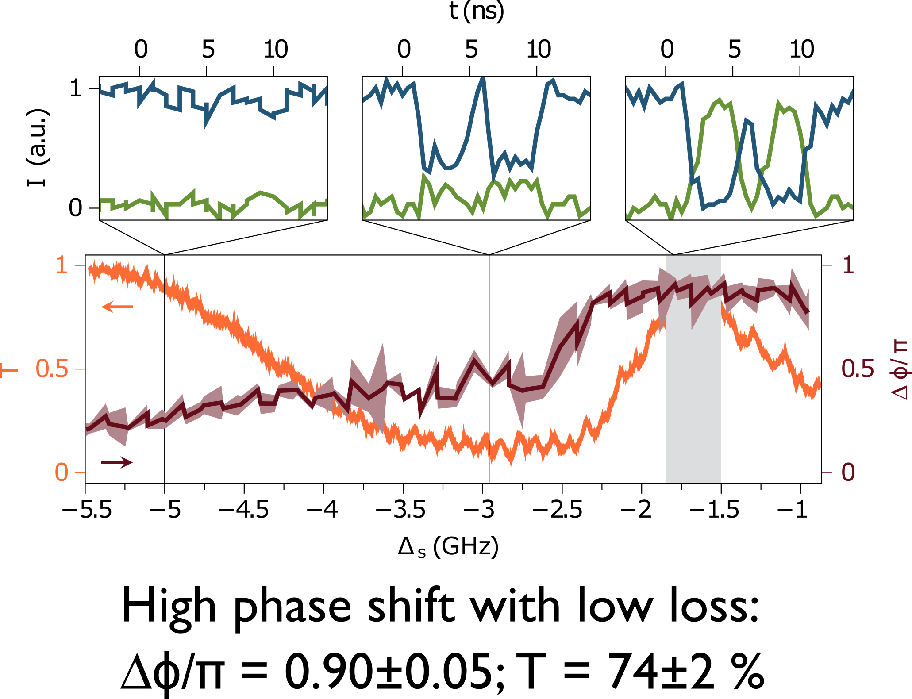
All-optical phase modulation: results

Slide 20
Phase modulation back to optical memory
Phase modulation
Port switching
Quantum memory

Slide 21
All-optical switching mediated by Rb
Arxiv: 2309.04313

Slide 22
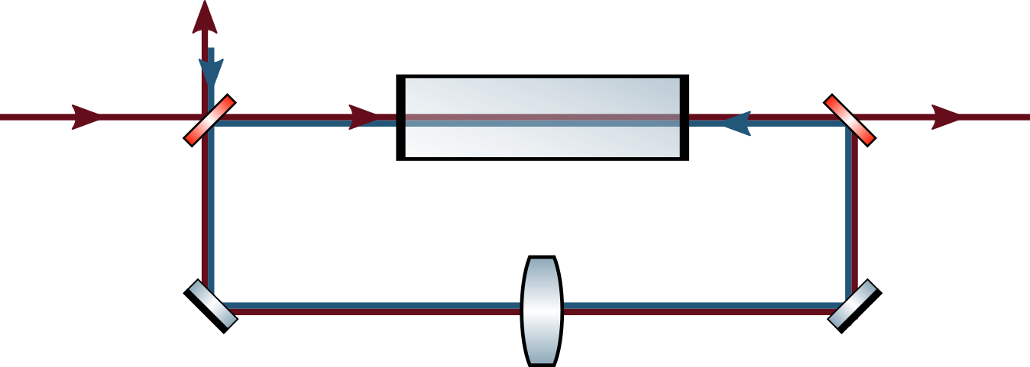
How do you store a photon?
How do you switch a photon?
Realise directly with a cavity
Reflected output
Transmitted output
Signal input
Vapour cell

Slide 23
Cavity-integrated optical switch
Control field changes susceptibility as before
Effectively changing refractive index of cavity
Rapid switch of cavity from strong transmission to strong reflection
Reflected output
Transmitted output
Signal input
Vapour cell

Slide 24
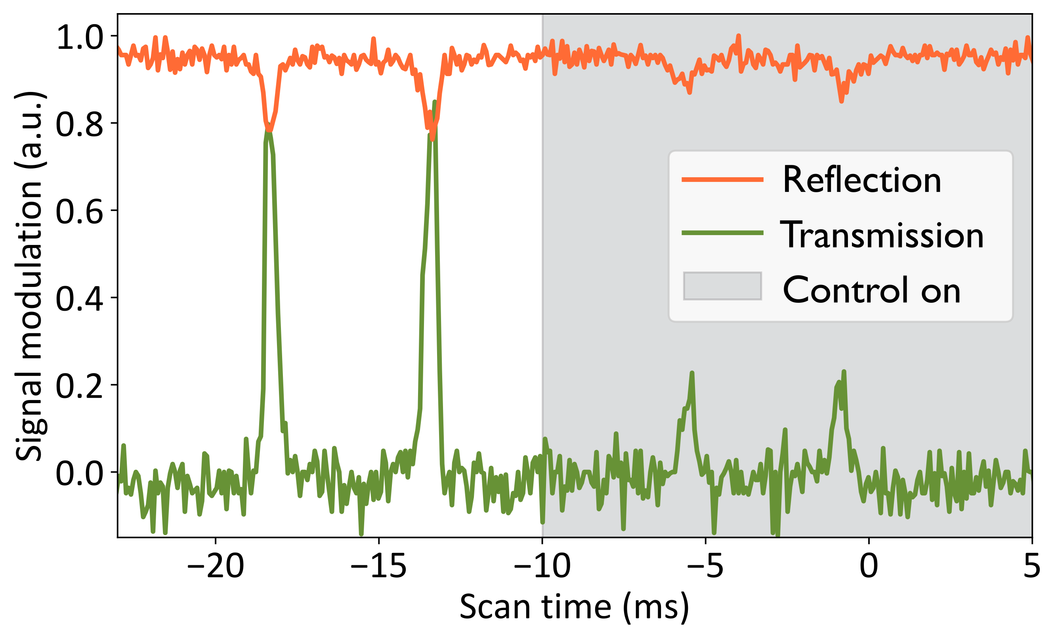
Cavity-integrated optical switch: results
Reflected output
Transmitted output
Signal input
Vapour cell

Slide 25
Cavity-integrated optical switch: future
Lock lasers off-resonance for high transmission
Rapid switching with EOM to modulate control field

Slide 26
Miniaturisation: in-fibre vapour cell
Atoms inside a hollow core fibre
Low-loss interconnections via GIF lens

Slide 27
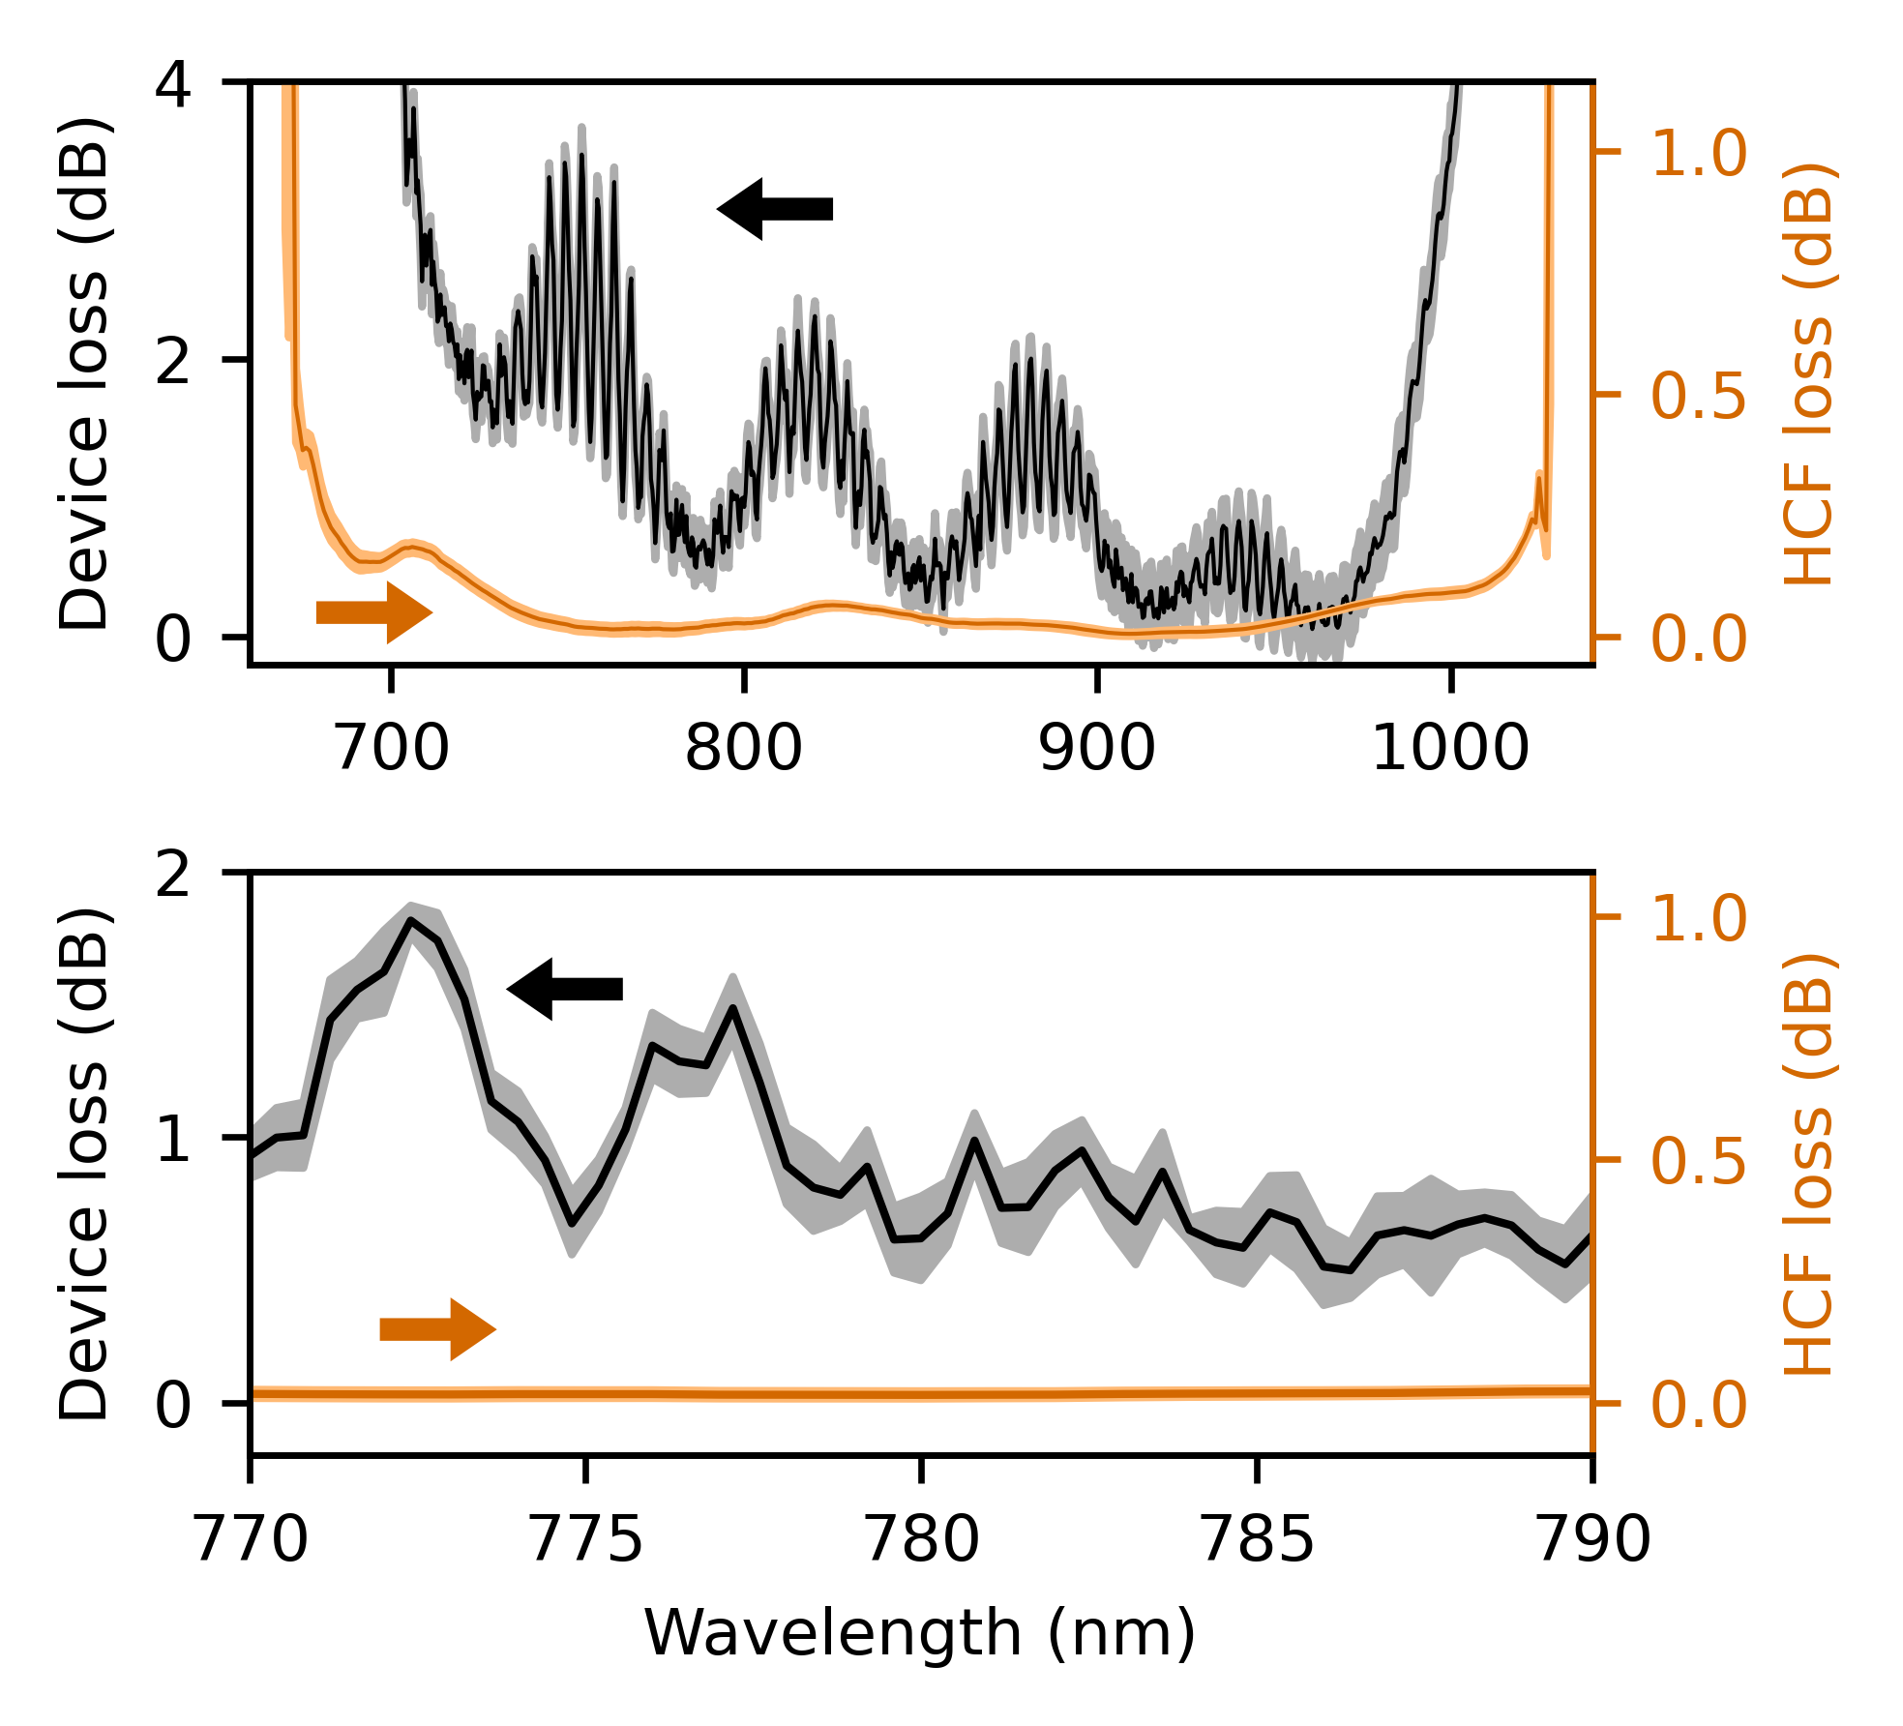
Low-loss fibre interconnects
Device insertion loss 0.6(2) dB at 780 nm
Mode matching with GIF lens
HCF loss given over 50cm (cell length)

Slide 28
Low-loss, fibre-integrated vapour cell
Arxiv: 2401.10651

Slide 29
Future work
Port-switching in a cavity
Phase modulation at telecoms wavelengths
Fill fibre cell with Rb

Slide 30
Thank you

Slide 31
Emergency slides

Slide 32
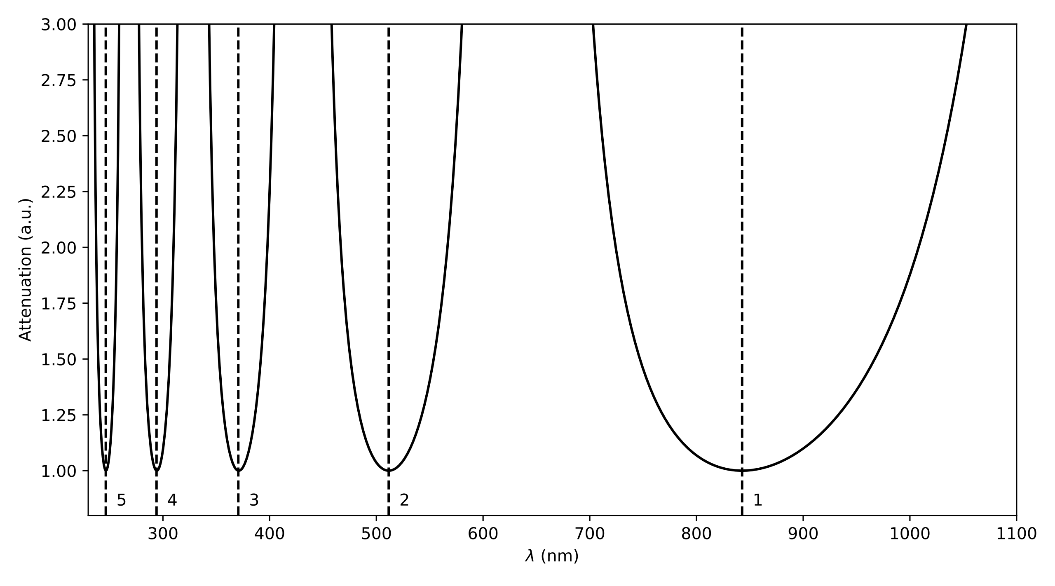
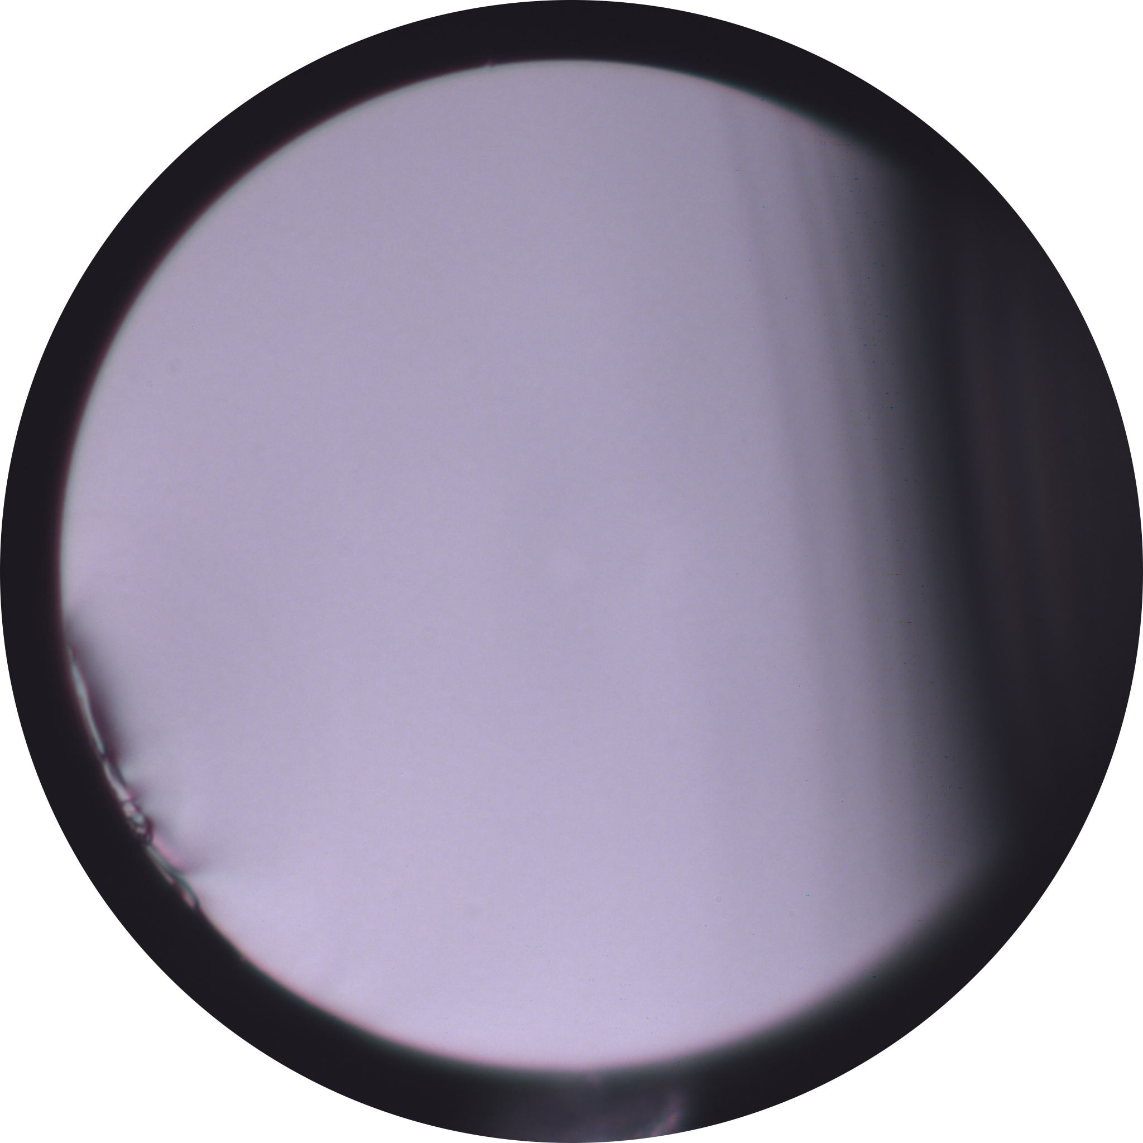
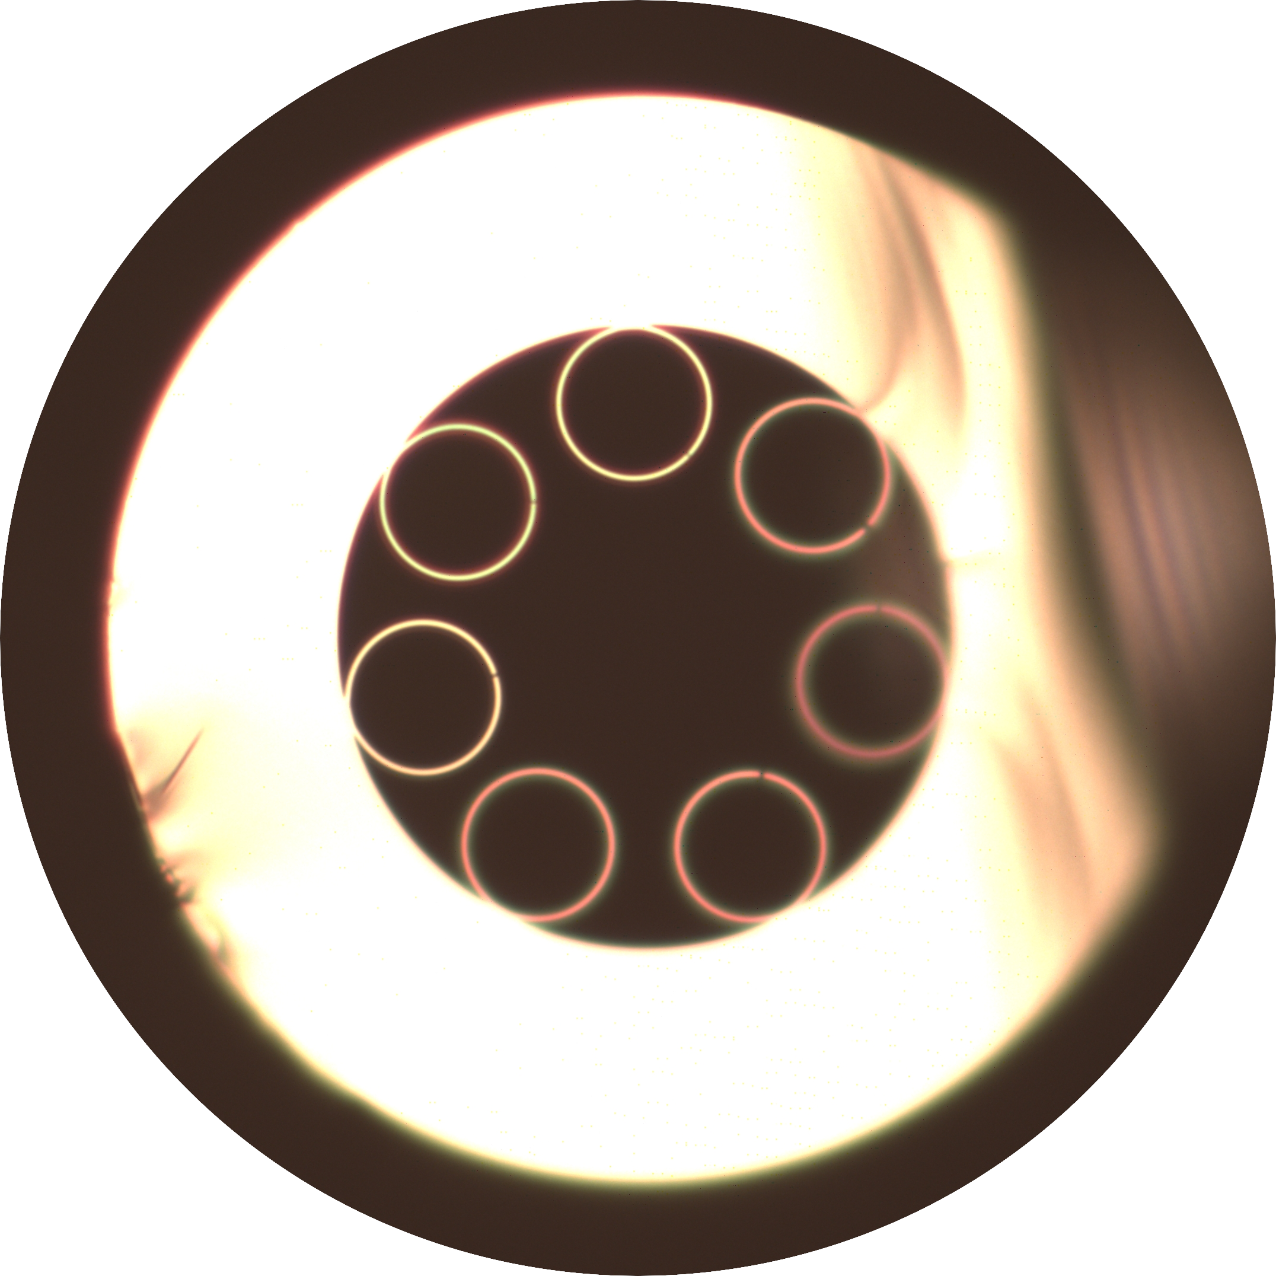
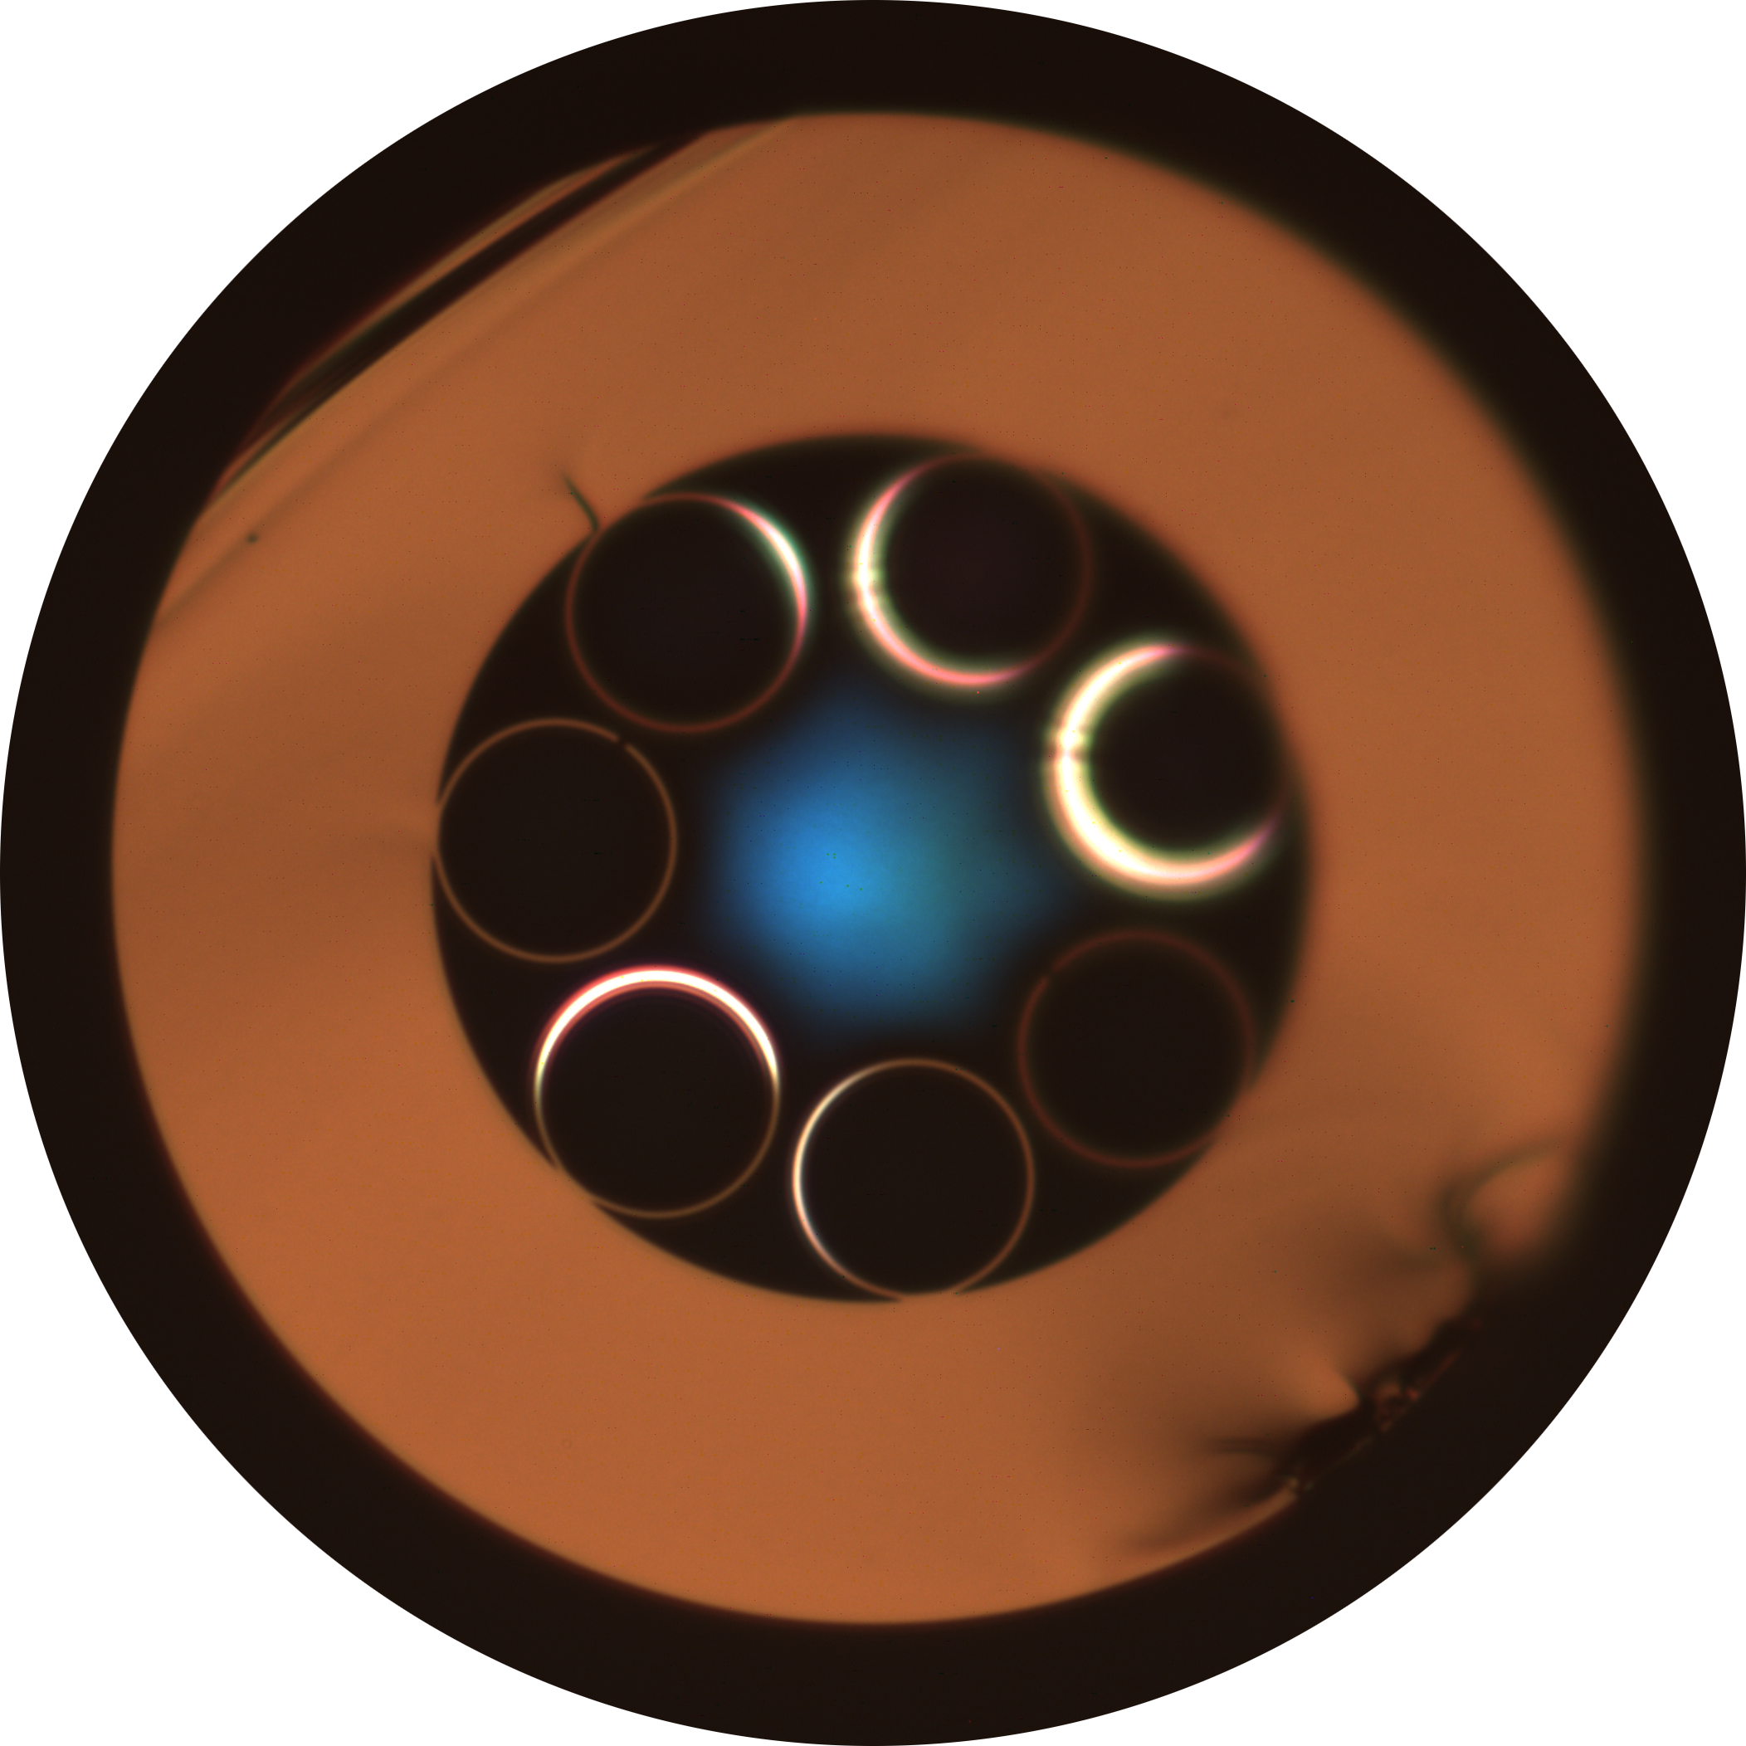
Exactly one slide about hollow core optical fibre (HCF)
Cladding
Jacket
Stray light in resonator
Light guided
in core
Core
SMF
25 μm
HCF
HCF
Resonator

Slide 33
How to fabricate fibre

Slide 34
Cleave GRIN to length with customised tension cleaver

Slide 35
Previous work
Big macroscopic cold splices (or no loss reported)
Not encapsulated
Telecoms wavelengths
Dmytro Suslov et al All-fiber hollow-core fiber gas cell. Optical Fiber Technology, Vol 81 (2023). DOI:10.1016//j.yofte.2023.1035113

Slide 36
A robust splice inside a capillary

Slide 37
Mode matching with a GRIN lens

Slide 38
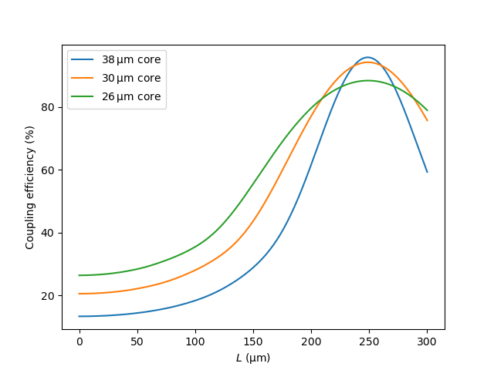
Mode matching with a GRIN lens
L

Slide 39
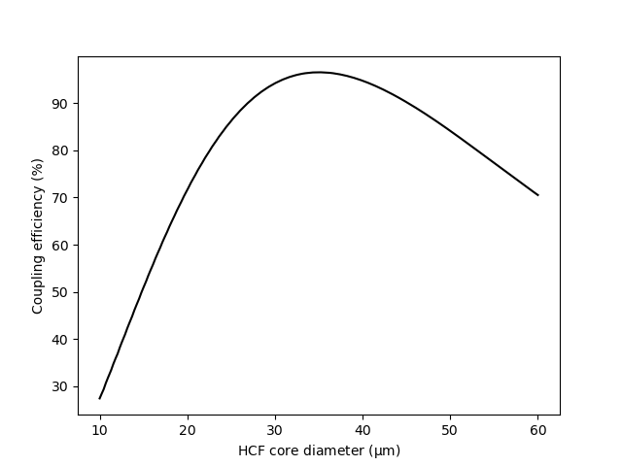
Mode matching with a GRIN lens
50 μm

Slide 40
Cut back experiment

Slide 41
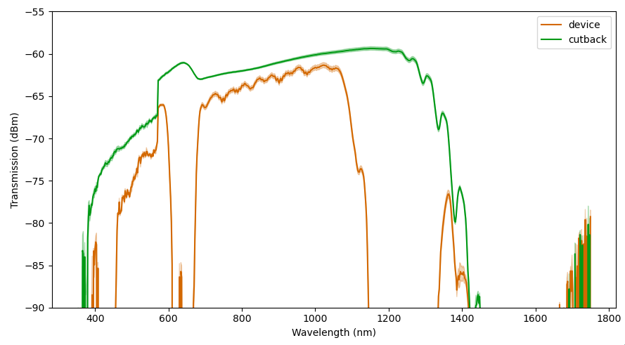
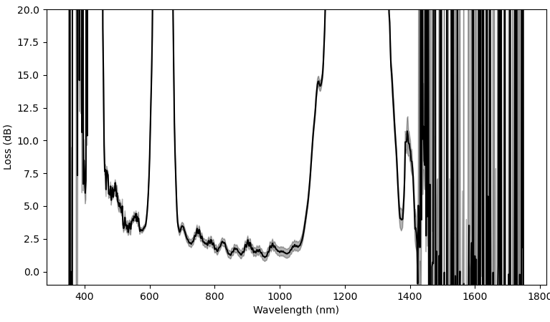
Results: cutback and measure loss

Slide 42
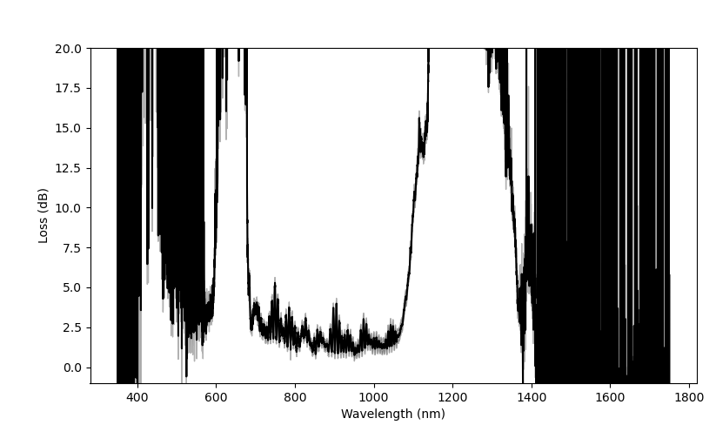
Results: high resolution reveals beating

Slide 43
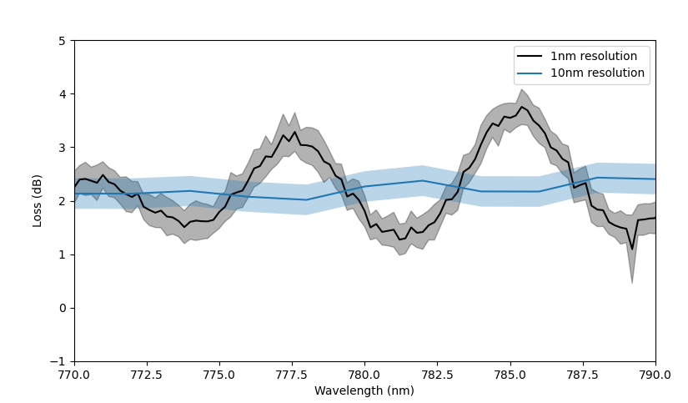
Results: near wavelength of interest

Slide 44
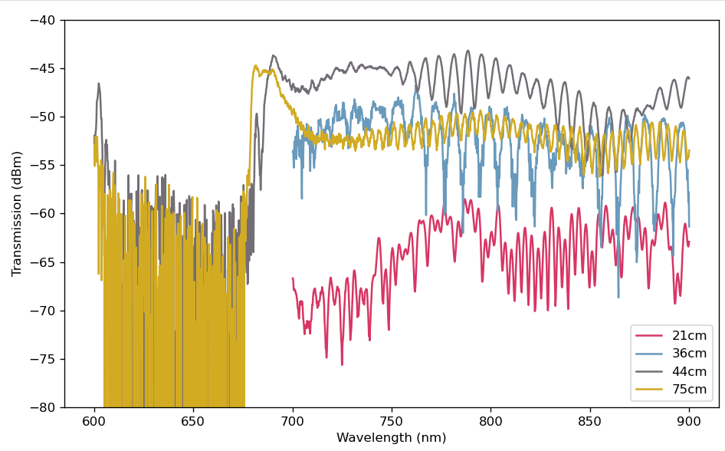
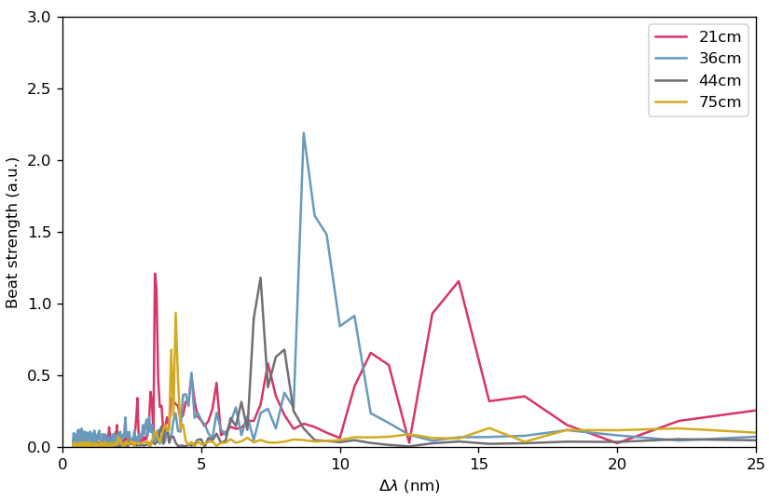
Multiple modes in the HCF
Testing different HCF lengths

Slide 45
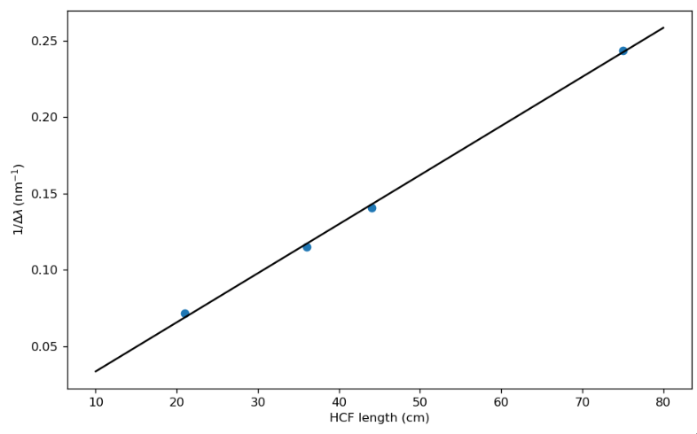
Multiple modes in the HCF
Testing different HCF lengths
$$\frac{1}{Δλ}=\frac{U_{A}^{2}− U_{B}^{2}}{8π^{2}ρ^{2}} L$$

Slide 46
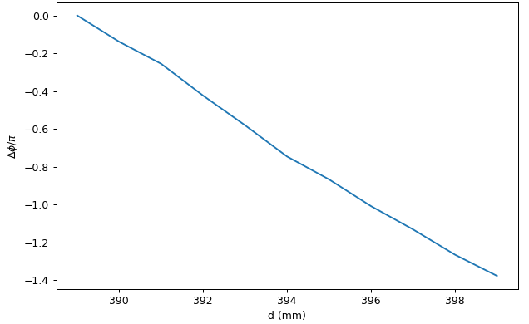
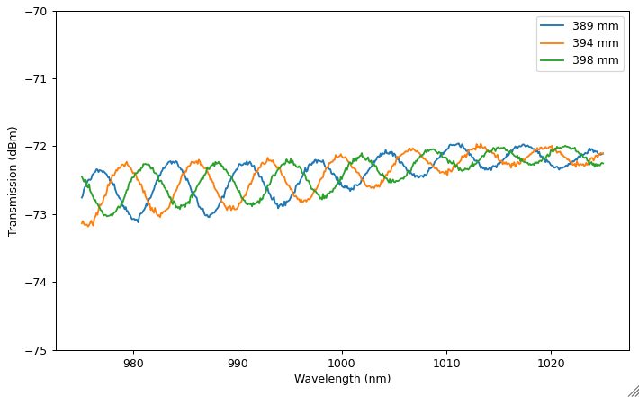
Phase matching to optimise transmission

Slide 47
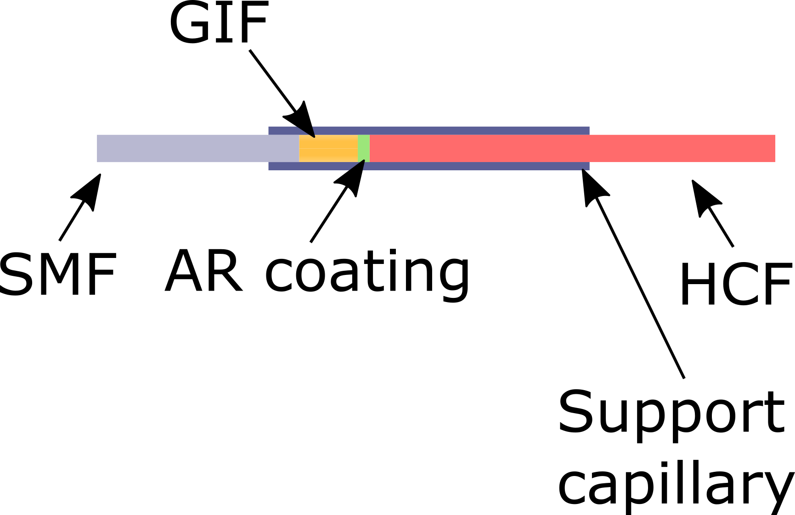
AR coating improvements

